Slide 1
Decorator Pattern
En Verden af Dekorationer

Slide 2
Problemstilling
Basal funktionalitet skal forøges
Nedarvning kan blive stort
GoF
"Attach additional responsibilities to an object dynamically. Decorators provide a flexible alternative to subclassing for extending functionality."

Slide 3
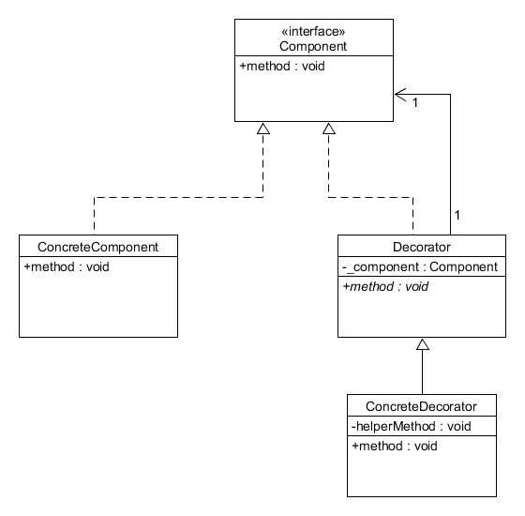
Uml

Slide 4
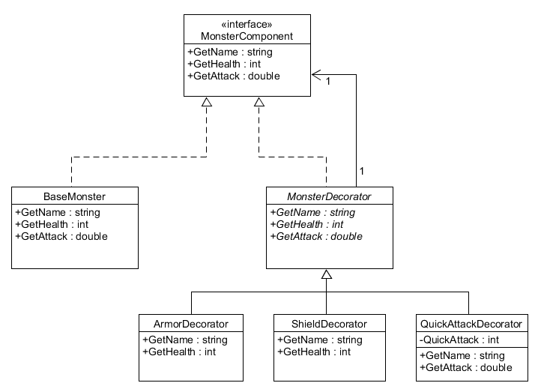
Eksempel

Slide 5

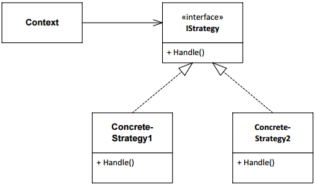
Sammenligning med strategy
Strategy

Slide 6
Konklusion
Udvide
Decorator VS nedarvning VS strategy
Open Closed principle

